Slide 1
华东师范大学

Slide 2



AQP++: Connecting Approximate Query Processing With Aggregate Precomputation for Interactive Analytics
汇报人：夏江华
2021年1月6号

Slide 3
This talk
Background
Motivation
Related knowledge
Framework Design
Implementation and Evaluation

Slide 4
Background
Interactive analytics requires database systems to be able to answer aggregation queries within interactive response times.
Challenging: the amount of data is continuously growing at an unprecedented rate
How to solve?
approximate query processing (AQP)
aggregate precomputation (AggPre)

Slide 5
approximate query processing (AQP) :
creates a random sample of data and uses the sample to estimate query results.
aggregate precomputation(AggPre):
precomputes the answers to some aggregation queries and then uses the precomputed aggregates to speed up query performance.
sample
C | SUM(A)
(1,1) | 1
(1,2) | 3
…
(1,10) | 15
AQP
AggPre

Slide 6
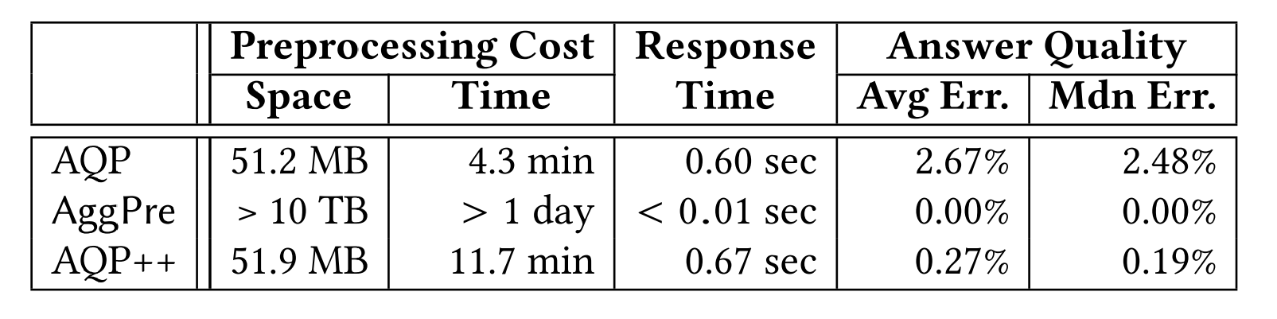
Motivation
C | SUM(A)
(1,1) | 1
(1,2) | 3
…
(1,10) | 15
Not calculated
AQP++
answer quality may be bad
preprocessing cost is high(time and space)

Slide 7
AQP
 | SUM | COUNT | AVG | stratified sampling | outlier indexing | unbiasedly
AQP | √ | √ | √ | √ | √ | √
AQP++ | √ | √ | √ | √ | √ | √

Slide 8
Aggregate Identification
evaluation function
q = SUM(1:10)
pre = SUM(2:10)
pre = SUM(1:9)
Which?

Slide 9
Aggregate Precomputation
equalpartition scheme+Heuristic optimization
C | SUM(A)
(1,2) | 1
(1,4) | 5
(1,6) | 10
(1,8) | 15
(1,10) | 20
C | SUM(A)
(1,1) | 0
(1,3) | 3
(1,5) | 9
(1,7) | 14
(1,9) | 18
C | SUM(A)
(1,2) | 1
(1,3) | 3
(1,4) | 5
(1,9) | 18
(1,10) | 20
Size=5
which aggregate values should be precomputed？

Slide 10
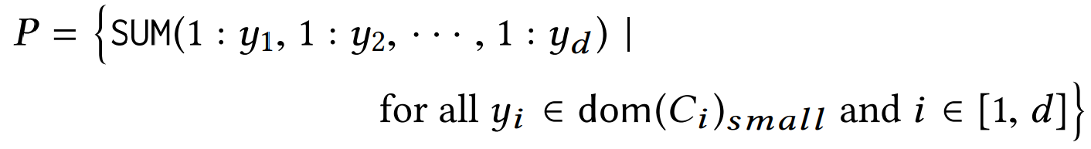
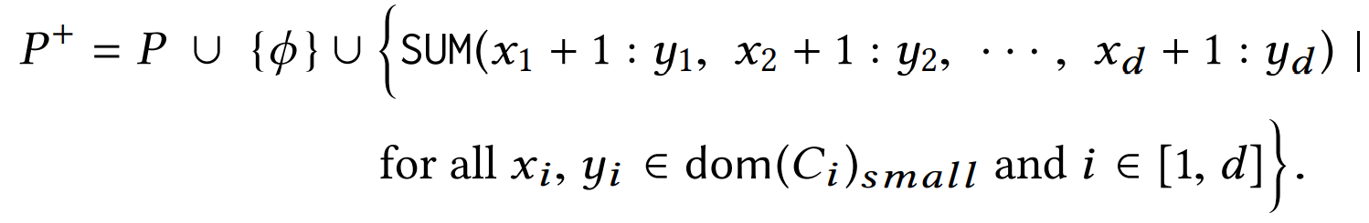
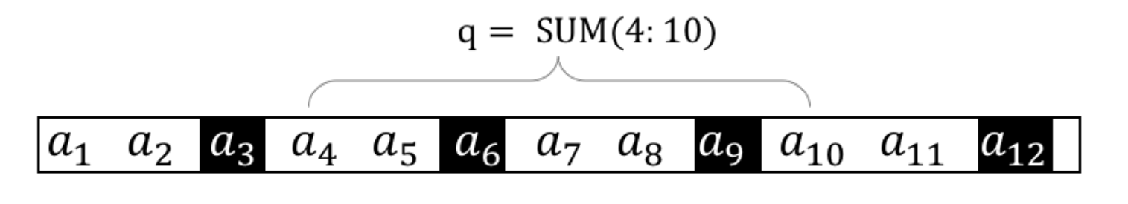
Related knowledge—AggPre
Aggregate Identification:
Let P denote a BP-Cube, i.e.
P + is the answers to all the queries :

Slide 11

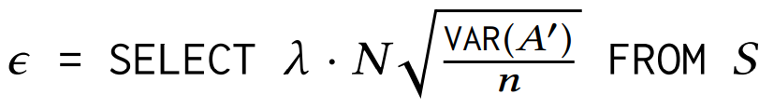

Related knowledge—AQP
Based on the Central Limit Theorem
q : SUM(1 : 4). Imagine AQP++ leverages the precomputed query pre : SUM(2 : 4) and returns 1000 ± 5 (confidence level: 95%)

Slide 12







Framework Design
AQP++:
AQP++ subsumes AQP:
AQP++ subsumes AggPre:
AQP
AggPre

Slide 13
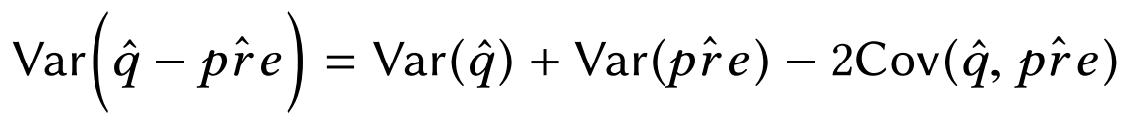

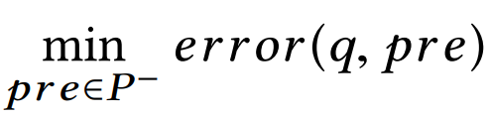
Aggregate Identification
When AQP++ is better than AQP?
Cov(qˆ,preˆ ) depends on the degree of the correlation between a user query result and a precomputed aggregate.
AQP++ can have a smaller variance than AQP.
AQP++ tends to return a more accurate result in this situation.
Aggregate Identification:

Slide 14
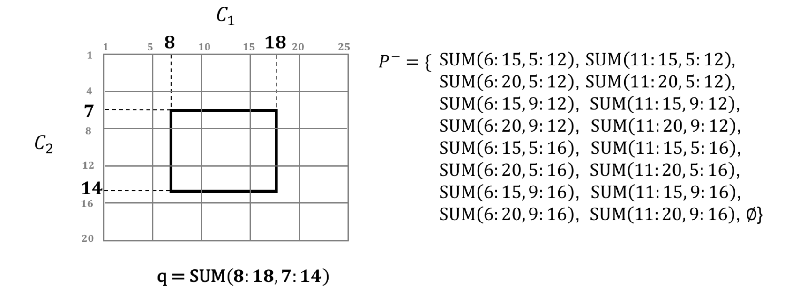

Slide 15
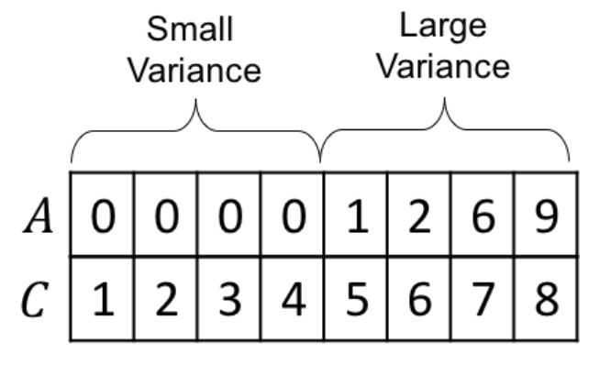
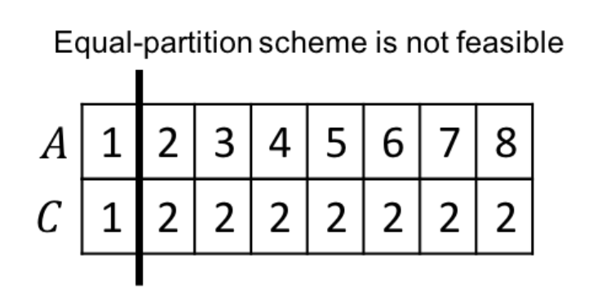
Aggregate Precomputation
equal-partition scheme
An Adaptive Approach Based on Hill Climbing
(1) how to find an initial BP-Cube
(2) how to evaluate the effectiveness of a BP-Cube
(3) how to adjust a BP-Cube
We first give the upper bound of error(q, P), and then we present an efficient linear algorithm to compute the upper bound of error(Q, P).

Slide 16


How to compute the upper bound?

Slide 17
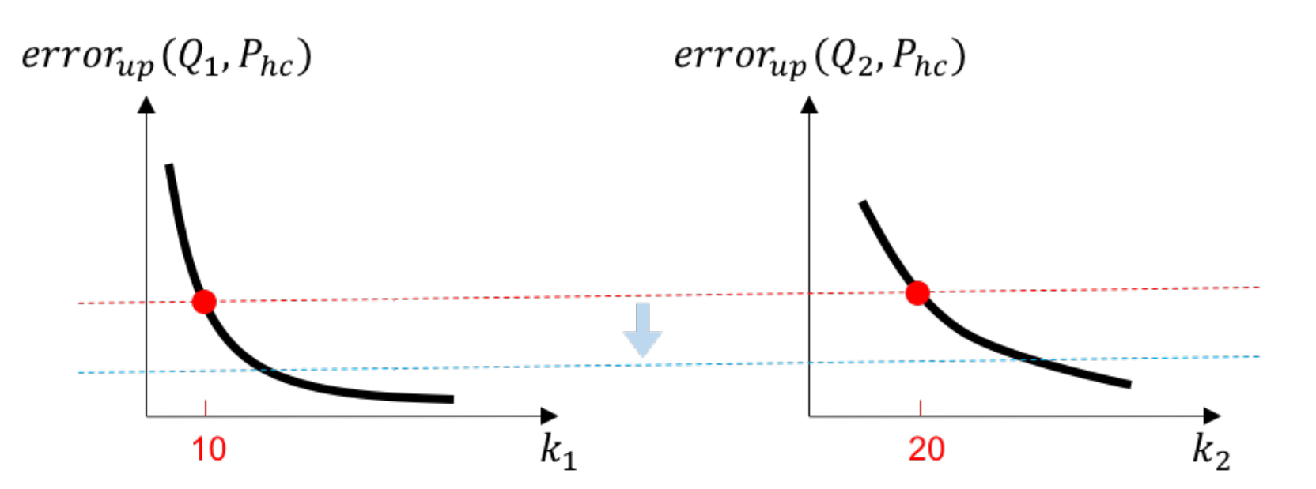

Slide 18
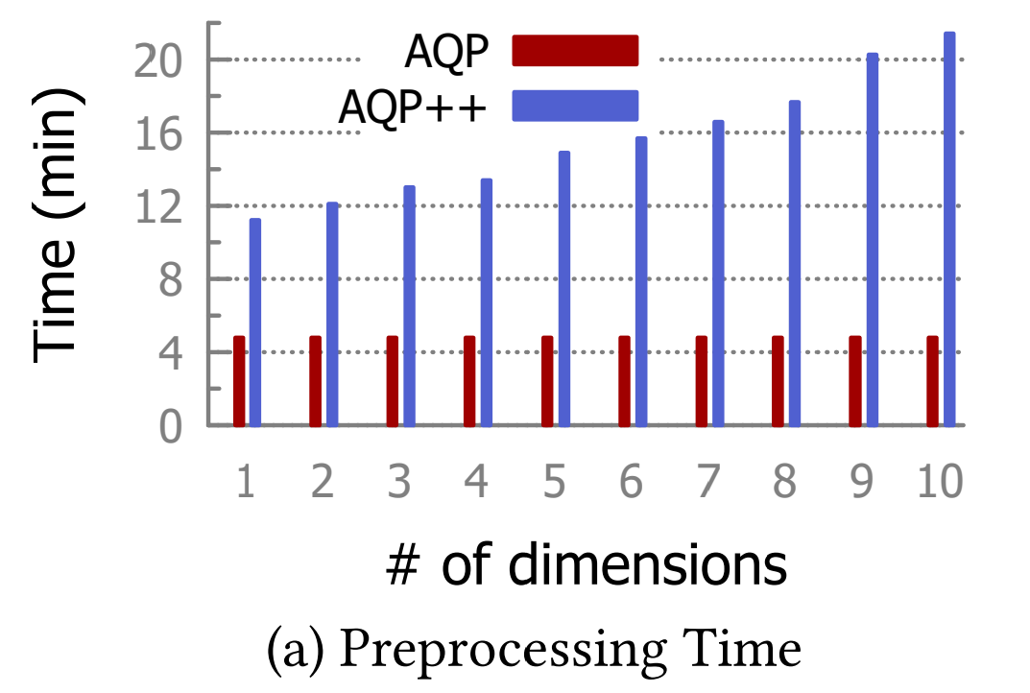
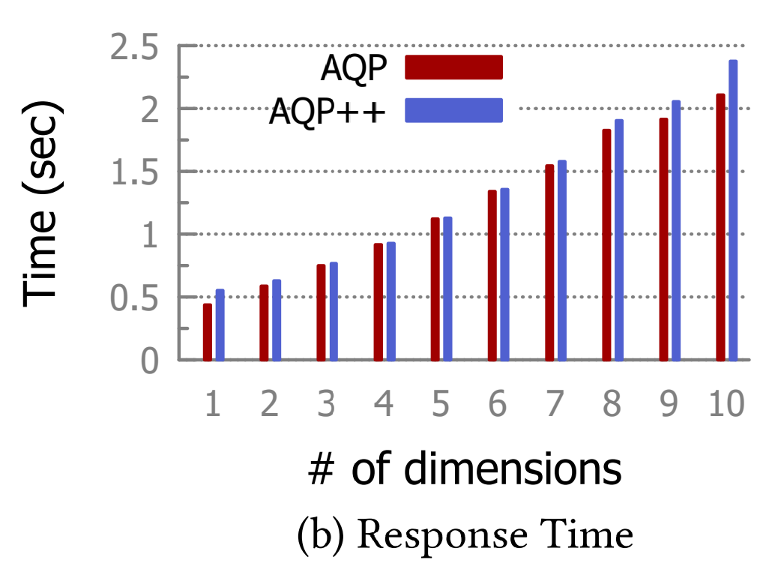
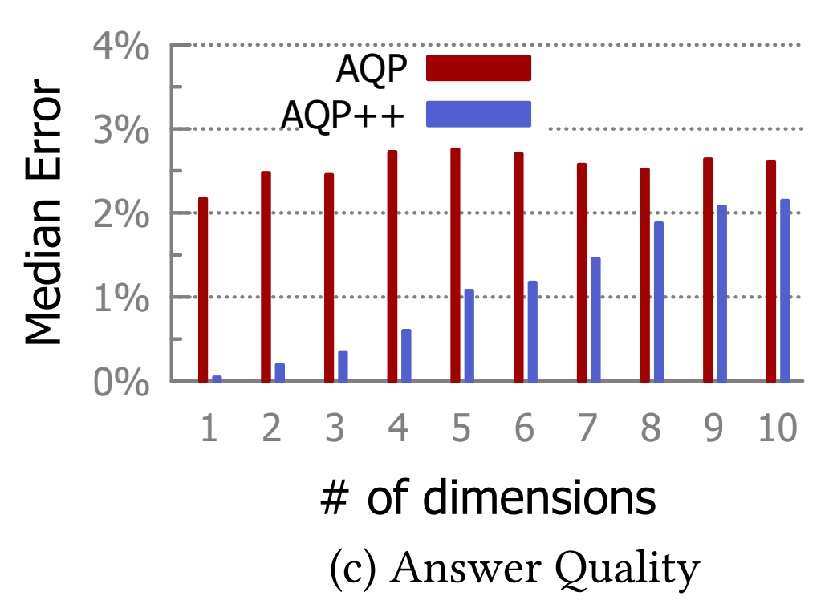
chulishijian
Implementation and Evaluation
预处理时间长
响应时间略高
错误率低

Slide 19
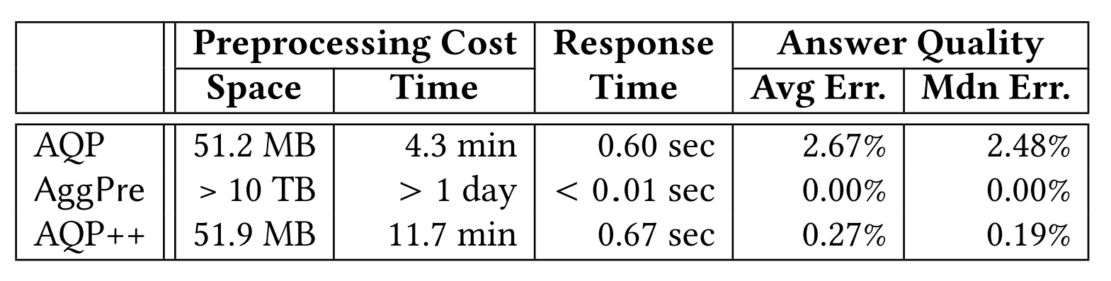

Slide 20
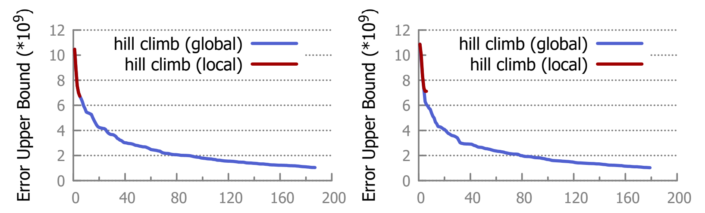

Slide 21
谢谢

